Slide 1

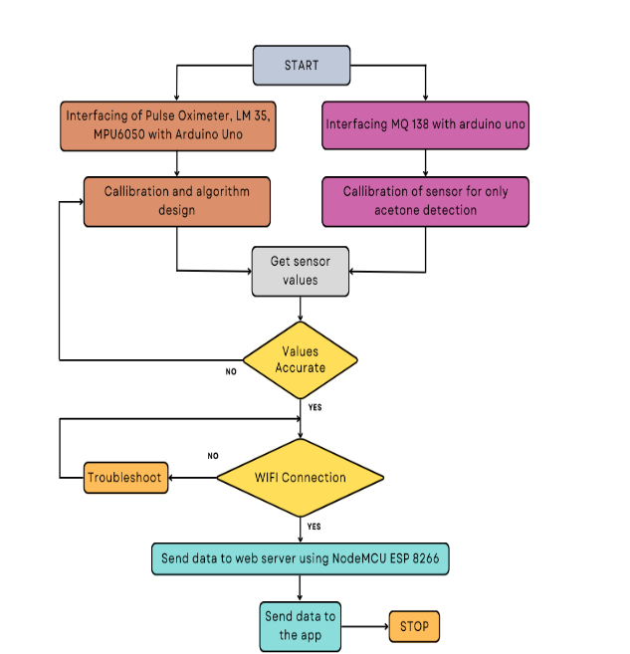
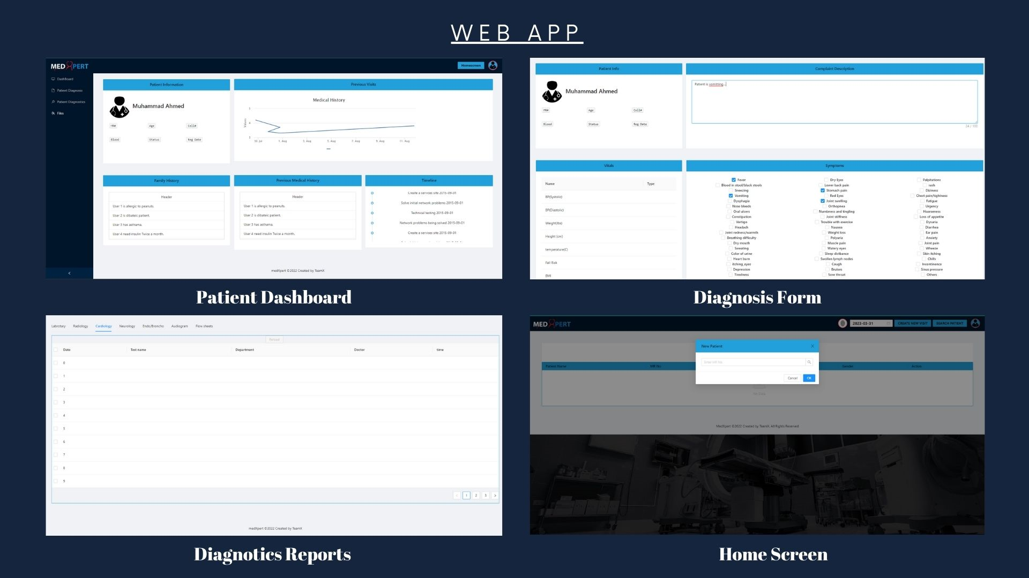
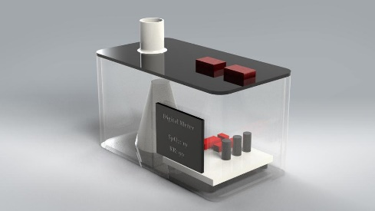
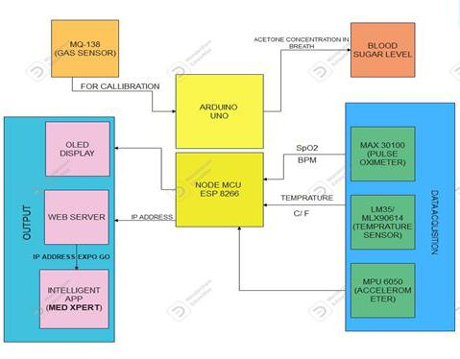
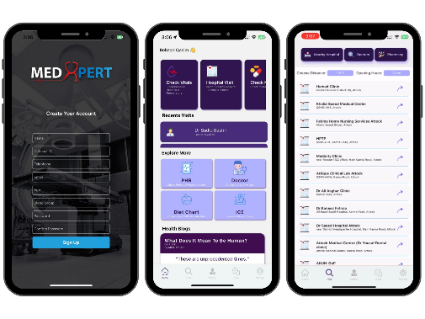
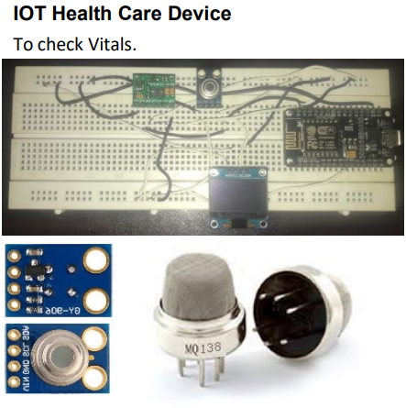
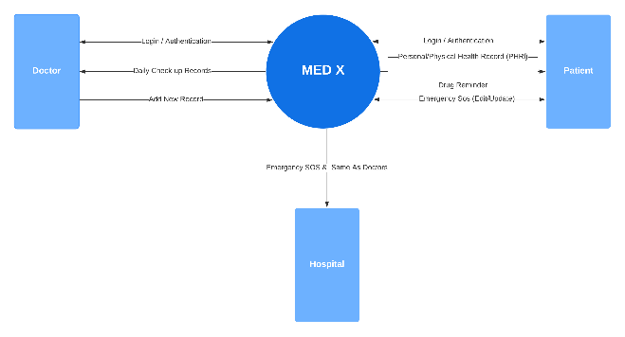
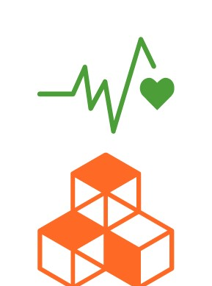
IOT BASED HEALTH MONITORING SYSTEM FOR DIABETIC ^{Final Year Project (2019-2023)} Department of Electronics Engineering University Of Engineering Technology, Taxila
Introduction
This digital application is available on Android and as a website. It allows ordinary people and patients to keep a personal medical log, request rescue in emergencies, and contact guardians. The app records medication history and serves as a reminder. The web version is for doctors, providing comprehensive patient check-up records, medical history, and surgery reports. The app offers doctor recommendations based on ratings and includes filters for specific searches, improving the user experience.
SDGs
Good Health and Well-being
Industry & Innovation
Architecture
System Architecture
Workflow Diagram
Results
Application
Mobile App
Prototype
Future Directions
Integration with more IoT devices
Machine learning and predictive analytics
Telemedicine capabilities
Group Members
Obaid Ur Rehman (19 ENC 11)
Usama Rauf Khattak (19 ENC 33)
Supervisor:
Dr. Amir Rashid

